Slide 1
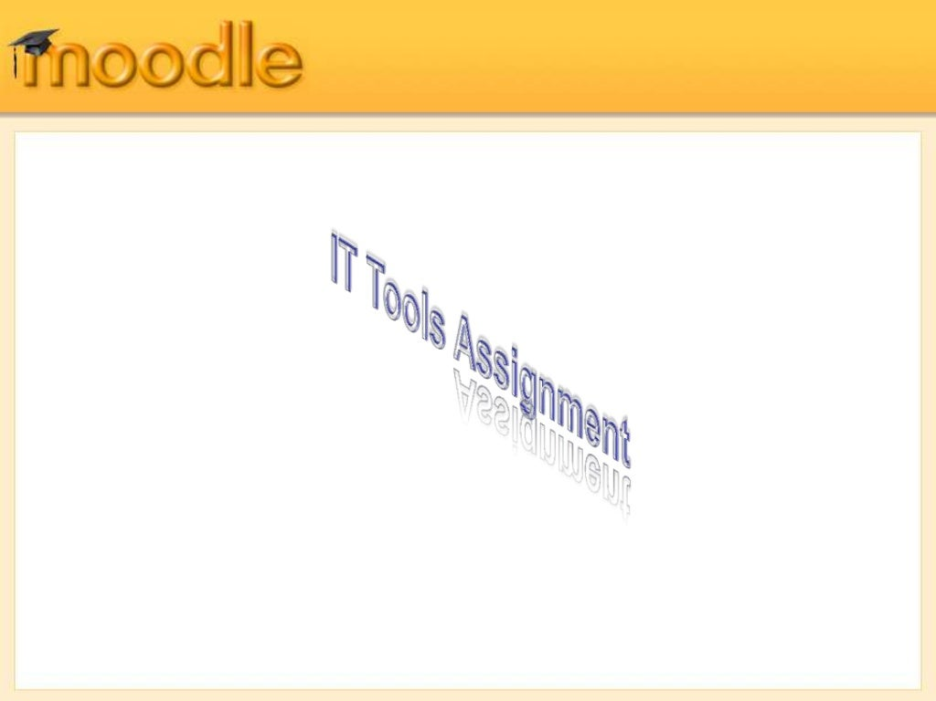
STEFFY FERNANDES
GVM’S GGPR COLLEGE OF COMMERCE & ECONOMICS
PONDA-GOA

Slide 2
Moodle is an alternative to proprietary commercial online learning solutions, and is distributed free under open source licensing. An organization has complete access to the source code and can make changes if needed. Moodle's modular design makes it easy to create new courses, adding content that will engage learners.

Slide 3
Moodle is as interactive and helpful D teaching and learning as allow it to.
You have to think creatively to allow it to be of use to you and your students.
Let the Moodle Learning Management System be your 365/24/7 teaching and learning aid.
Request new Moodle courses from the VSR.

Slide 4


Slide 5
what do you want from an online learning system?
Easy creation of courses from existing resources?
Course content which can be re-used with different learners, including content from other vendors (Blackboard, WebCT etc.)?
Learner involvement?
Enrolment and learner authentication which is simple yet secure?
Intuitive online learner and teacher management features?
An active support community to help solve problems and generate new ideas?
Affordability?

Slide 6
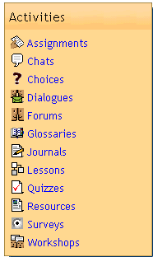
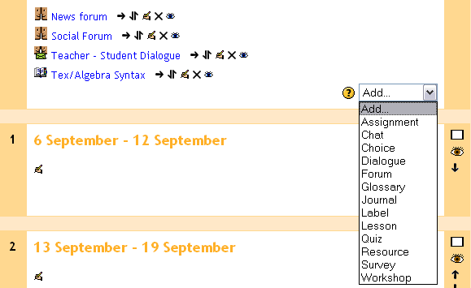
Getting Started
Moodle has a “modular” design so adding the Activities that form a course is a simple process:
1. Course creation privileges are assigned to the teacher.
2. Select from one of three course layout; Topic, Weekly or Social format.
3. Click “Turn editing on” within the blank course template.
4. Create the course!
With editing turned on, the course creator can now Add activities from an intuitive drop-down list of module plug-in features.

Slide 7
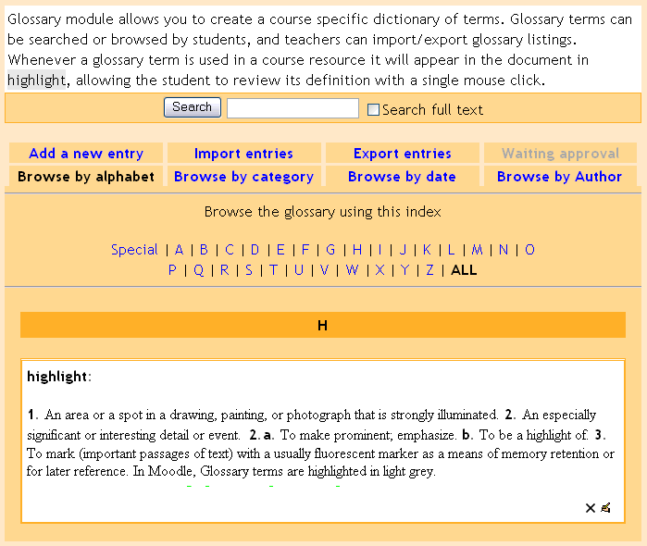
Course Management Features - Modules
Glossary Create a glossary of terms used in a course. Has display format options including entry list, encyclopaedia, FAQ, dictionary style and more.
Journal Learners reflect, record and revise ideas.
Label Add descriptions with images in any area of the course homepage.
Lesson Allows instructor to create and manage a set of linked "Pages". Each page can end with a question. The student chooses one answer from a set of answers and either goes forward, backward or stays in the same place in the lesson.

Slide 8
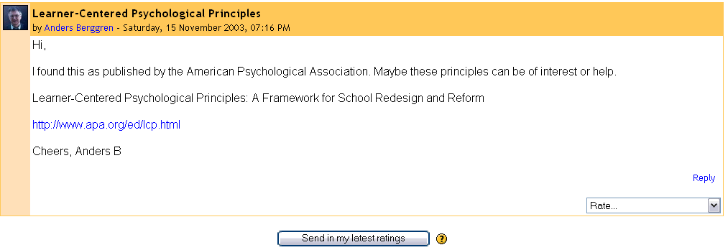
Course Management Features - Modules
Forums
Threaded discussion boards for asynchronous group exchange on shared subject matter. Participation in forums can be an integral part of the learning experience, helping students define and evolve their understanding of subject matter.
Students can Rate a forum post, based on Scales set up by the course creator

Slide 9
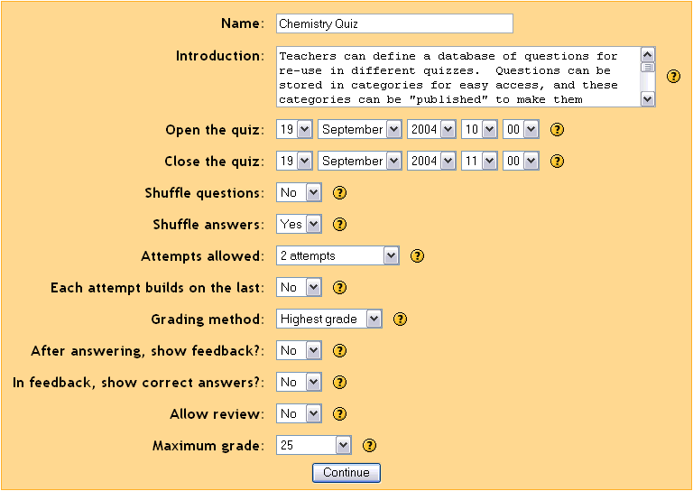
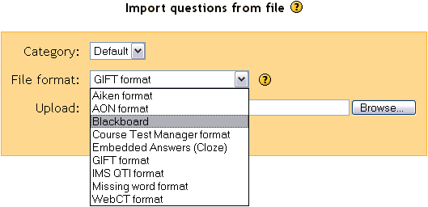
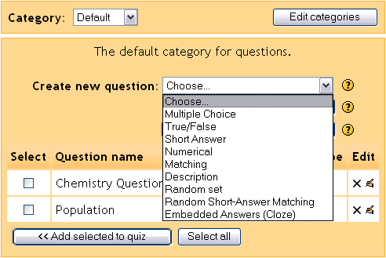
Course Management Features - Modules
Quiz Create all the familiar forms of assessment including true-false, multiple choice, short answer, matching question, random questions, numerical questions, embedded answer questions with descriptive text and graphics.
Instructors have granular control in defining course assessments, and can import quiz questions from popular formats like Blackboard, IMS QTI and WebCT. Moodle also supports embedding audio into a quiz.

Slide 10
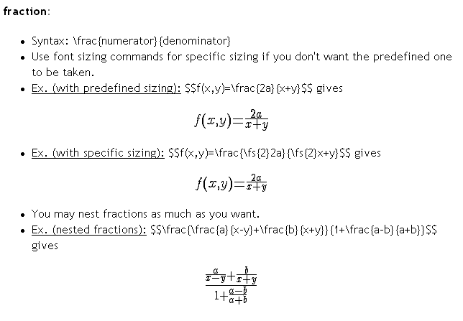
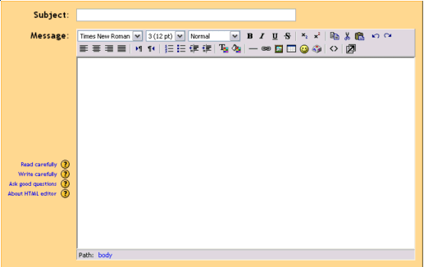
Course Management Features - Modules
Resource The primary tool for bringing content into a course; may be plain text, uploaded files, links to the web, Wiki or Rich Text (Moodle has built-in text editors) or a bibliography type reference.
Survey This module aids an instructor in making online classes more effective by offering a variety of surveys (COLLES, ATTLS), including critical incident sampling.
Workshop An activity for peer assessment of documents (Word, PP etc.) that students submit online. Participants can assess each other’s project. Teacher makes final student assessment, and can control opening and closing periods.
Moodle supports adding math expressions to a Resource activity, using the built-in HTML editor

Slide 11
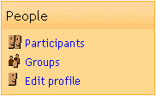
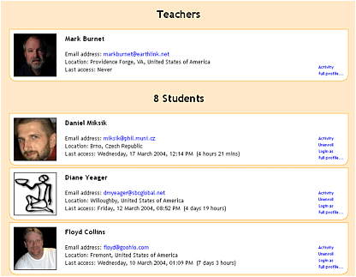
Learner Management Features – Participants
One click and you can view activity from all participants enrolled in the course. Learners create a personal profile that can include a picture, helping connect students socially in the online learning community.
Learners complete a personal profile page that helps build the online learning community. Adding a picture and details to the profile creates a social connection.

Slide 12
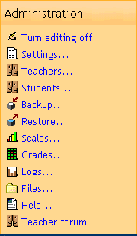
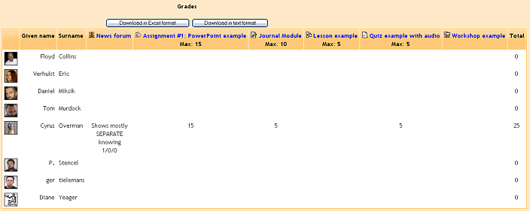
Learner Management Features - Grades
The Grades feature in Moodle provides a quick view of all Forum, Assignment, Journal, Quiz, Lesson and Workshop grades. The grading scale applied to a learner’s submission is shown, along with a cumulative total, on a single page.
Grades can be downloaded in Excel or plain text for inclusion into an existing electronic gradebook

Slide 13
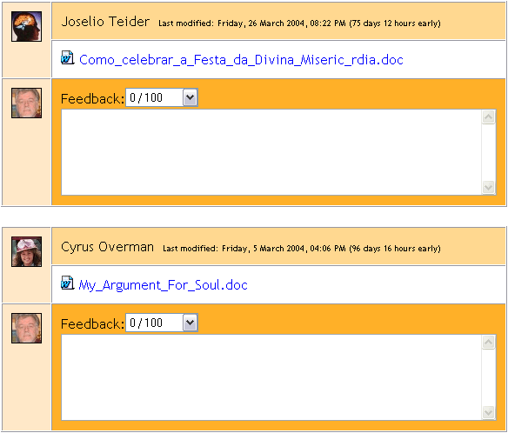
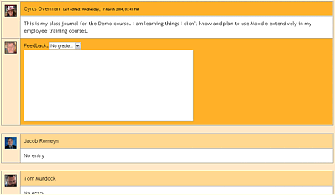
Learner Management Features - Grades
Viewing Assignment and Journal submissions, and adding Grades and comments, are done from a single page that displays all enrolled students.
Managing student submissions are done from one central screen. This cuts down on the time it takes to assess many students work.

Slide 14

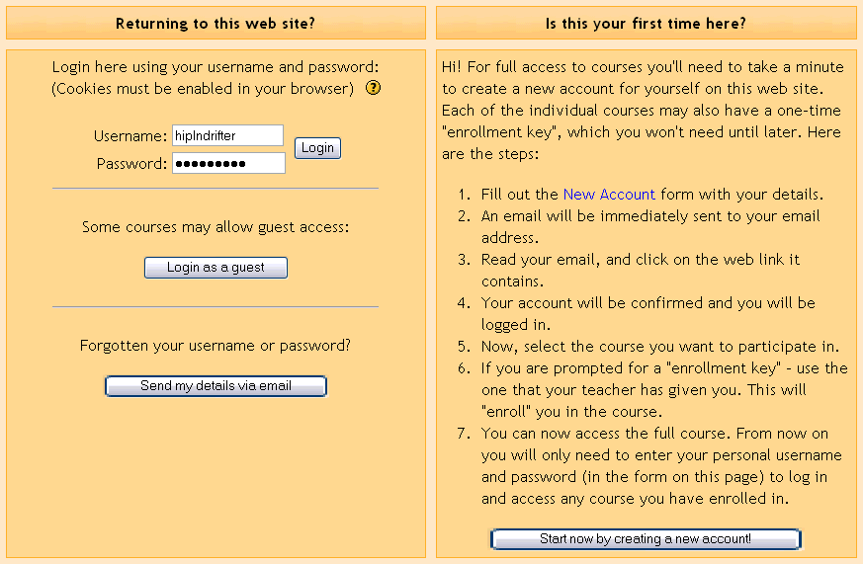

Learner Experience - Login
Learners find it easy to navigate a Moodle course homepage in their browser; intuitive “breadcrumb” links are always present. Login occurs on a familiar screen. Initial account set up may be handled by the learner or administrator.
Navigation bar provides breadcrumb links from course homepage to activities
Moodle's has its own authentication system, but will integrate with an external database, POP3, IMAP, LDAP or NNTP, allowing domain wide login.

Slide 15
Manage your course
Set up your course
Add students
Track progress
Upload files

Slide 16
Course homepage
Classic theme
1.Navigation block
Normally visible on all pages, this block helps you find your way around the course and site.
2.Administration block
Again, normally visible on all pages, this block gives different levels of access to teachers and students.
3. Turn editing on A clearly visible button allows you to turn editing on and off.
4. Course sections
Here is where the learning materials are displayed. This element may be arranged in one or multiple weeks, topics, forums or other (non-standard) layouts.
5. New feature in Moodle 4.0!Collapse all. Sections can be collapsed and expanded individually or you can use the Collapse all link to collapse them all at once.
6.Side blocks
Side blocks can be added when the editing is turned on.
Which blocks you see depend on what the administrator has selected and what you as teacher choose to add.

Slide 17
To edit a course section
Enable Edit mode/turn editing on
Quickly rename sections from the pencil icon.
If Restrict access is enabled for the site, access to the section (including all activities and resources within it) may be restricted.

Slide 18
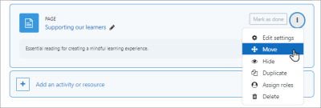
To move a course section
(Note:The ability to move course sections is controlled by the capability moodle/course:movesections, which is allowed for the default role of teacher.)
Enable edit mode/turn editing on.
Drag and drop the section either from the course central area or the Course index to your chosen location.
If your course is long you can also drag from the central area to a location in the Course index, and/or you can click the three dots next to a section, select Move and choose the location to move it to.

Slide 19
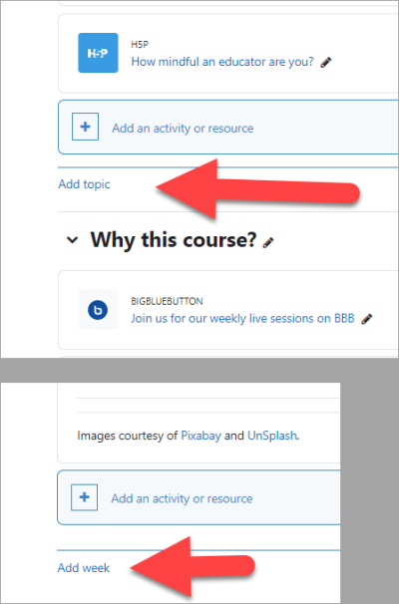
To add course sections
Enable edit mode/turn editing on.
If you are using Topics then find the location you want to add a new section and click Add topic.
If you are using Weeks then go to the bottom of the course page and click Add week.

Slide 20
To delete a course section
With the editing turned on, click the 'Edit' link to the right of the course section you wish to delete and then, from the menu that displays, click 'X Delete'. You will be prompted to confirm your wish to delete the section and its contents. Note that all activities inside the section and their user data will also be deleted. Use the Recycle bin to reverse this if you do it by mistake.

Slide 21
To link course sections
An admin setting Always link course sections can be enabled from Site administration > Appearance > Navigation and will link course sections so that when a course section name is clicked in the navigation block or the central content area, it will go directly to that section.

Slide 22
Blocks
The Boost and Classic themes only only displays blocks on the right, although contributed themes might display them on the left.
To add a block to the course page
Enable Edit mode top right.
Expand the block drawer and click Add block. Select your block.
To move a block
With Edit mode on, click the crosshair icon on a block.
While keeping the block selected, drag it to where you want to position it and let go.

Slide 23
Activities and resources
To add an activity or resource to the course
Enable Edit mode.
Click 'Add an activity or resource' to open the activity chooser. Double-click to add an activity or resource; click the i for more information and click the star icon to add it to a separate, starred tab.
Alternatively, certain resources and activities may be added using drag and drop:
To add a file, simply drag and drop it onto the course section where you'd like it to appear
To add a folder of files, simply zip the folder then drag and drop it onto the course section where you'd like it to appear, answer 'Unzip files and create folder' to the popup dialogue, then click the upload button
To add a SCORM package, simply drag and drop it onto the course section where you'd like it to appear, answer 'Add a SCORM package' to the popup dialogue, then click the upload button

Slide 24
Course Add students
The process of adding students to courses is called Enrolment. This is different from adding users to the site, which is known as Authentication. There are various methods of enrolling students into courses, once they have logged in to Moodle.
A teacher can view, activate, add and remove the enrolment methods within their course from the Enrolment methods link accessed either from the gear menu in the nav drawer Participants link, or from the More link in the course gear menu (or in Course administration > Users in the Administration block if you are using a theme other than Boost). It may also be the case that the students are automatically enrolled into the course by an administrative process, and the teacher does not need to do anything.

Slide 25
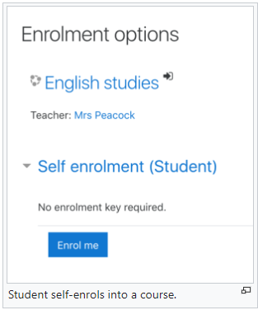
Students enroll themselves
If Self enrolment is enabled then students can sign up to courses themselves. The teacher can restrict enrolment to those who have been given an Enrolment key and, if needed, a staff member may be given the Keyholder role to manage enrolment keys.

Slide 26
Teachers manually enrol students
If Manual enrolment is enabled (and it usually is) then teachers may add students to their course from the nav drawer Participants link by clicking 'Enrolled users' in the gear menu (or in Course administration > Users in the Administration block if you are using a theme other than Boost).

Slide 27
Tracking progress
Grades
Every course has its own Gradebook which is accessible from Course administration > Gradebook setup. Some activities such as Assignment and Quiz send grades back to this gradebook. It is also possible for teachers to enter grades directly into the gradebook.

Slide 28
Competencies
Competencies describe the level of understanding or proficiency of a learner in certain subject-related skills. Competency-based education (CBE), also known as Competency-based learning or Skills-based learning, refers to systems of assessment and grading where students demonstrate these competencies.

Slide 29
Activity completion
If Activity completion is enabled by the administrator and in the course settings, teachers can indicate for each course item how they wish it to be registered as complete. A tick/checkmark will then appear against the activity. Students may either mark it complete manually or the item will automatically be registered as complete once a student has met the specified criteria. These may be viewing a resource, submitting an assignment, posting in a forum or other conditions. The teacher can see an overview of who has completed what in the activity completion report in Course administration > Reports > Activity completion.

Slide 30
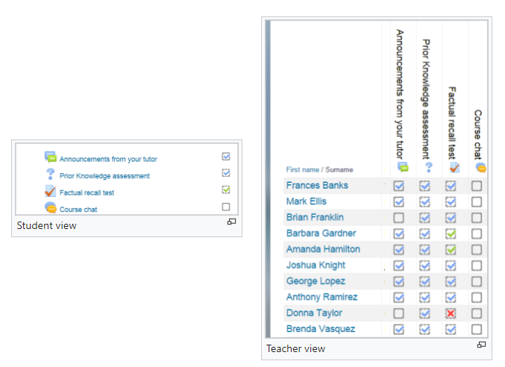

Slide 31
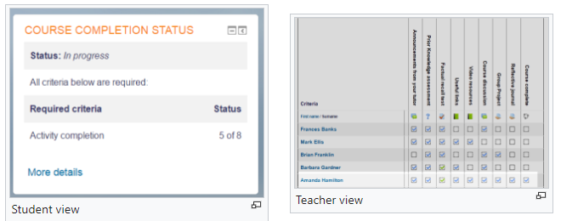
Course completion
As an extension of activity completion, enabling Course completion allows for a course to be officially marked as finished, either manually or automatically according to speficied criteria. If the Course completion status block is added, students can see their progress during the course. Teachers can view the overall progress of students towards course completion from Course administration>Reports>Course completion.

Slide 32
Badges
Badges can be awarded either manually or using activity completion settings in a course and are a popular way to motivate students. Students may be awarded badges at different stages of the course for different levels of progress.
Course reports
A number of Course reports are available to the teacher in their course to help them track the progress of their students. In addition to the activity and course completion reports mentioned above (which are only available if these settings are enabled) there are also activity reports, participation reports and general course logs.

Slide 33
Add a resource or activity
Instead of drag and drop, you can click the link 'Add an activity or resource' and select either File or Folder from the activity chooser.

Slide 34
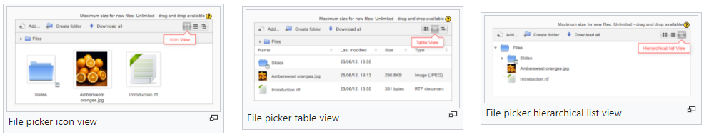
Viewing uploaded files
Once uploaded, files appear as thumbnails in the file manager for easy recognition.
Files view can be easily toggled between icons view or a table view with sizes and dates, or a hierarchical list view.

Slide 35
Editing or updating uploaded files
Clicking on the name of an uploaded file opens up a pop up dialogue box which allows file details quickly to be altered.

Slide 36
Manage your site
Add users
Add courses
Change the look and feel
Install plugins

Slide 37
Add users
Users may be added to a Moodle site in several ways. When user accounts are created on a site, the process is called Authentication, and when users join a course, the process is called Enrolment. Normally only the administrator is allowed to add users to a site. Course teachers can only add students to their course and do not have permission to add users to the site. (If you're a teacher looking for instructions on how to add students to your course, read Add students.)

Slide 38
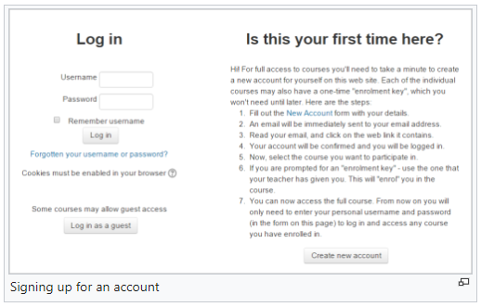
Users sign up to the site themselves
If you wish people to create their own accounts on your site, you must enable Email-based self-registration. This feature is disabled by default because of the possibility of spammers accessing your site.

Slide 39
The admin creates accounts manually
This process is called Manual authentication and is enabled by default on a site. You can lock certain fields, set password expiry dates, and configure other settings from Site administration > Plugins > Authentication > Manual accounts.
As an administrator, you can add users one at a time from Site administration > Users > Accounts > Add a new user. See the documentation Add a new user for more details.
You can also upload users in batches with a CSV file from Site Administration > Users > Accounts > Upload users. See the documentation Upload users for more details.
The CSV file will also upload users directly into courses and groups within those courses. In the example below, new students are added to the site and enrolled in specified groups in two courses, English and Mathematics. (The courses need to exist already, but if the groups do not already exist, Moodle will create them on upload.)

Slide 40
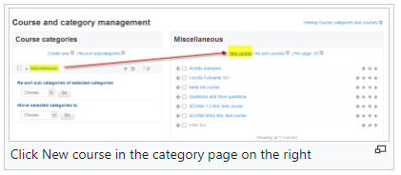
Adding a course
By default a regular teacher can't add a new course. To add a new course to Moodle, you need to have either Administrator, Course Creator or Manager rights.To add a course:
From the Site administration link, click Courses>Manage courses and categories.
Click on the category where you want your course to be. For more information see Course categories
Click the "New course" link
Enter the course settings, and then choose either to "Save and return" to go back to your course, or "Save and display" to go to the next screen.
On the next screen,if you have chosen "Save and display", choose your students/teachers to assign to the course.

Slide 41
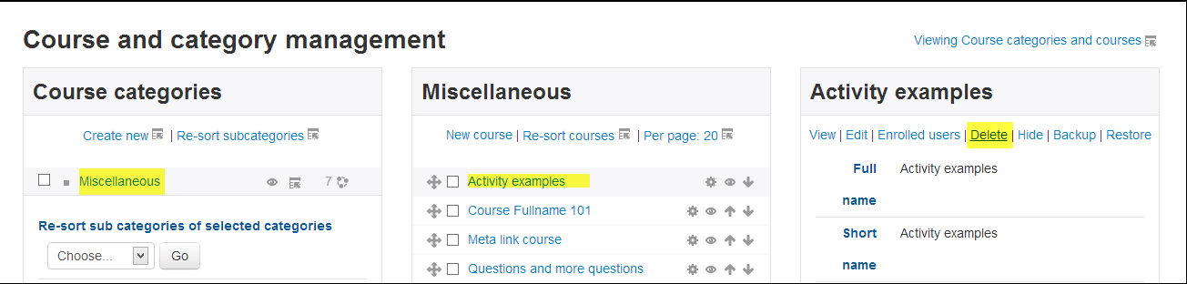
Deleting a course
Teachers cannot delete courses. Managers (i.e. users with a role for which the capability moodle/course:delete is allowed) can delete courses and course creators can delete courses they have created themselves, but only within 24 hours of creating the course. This is so that courses created by mistake may be deleted without needing to ask an administrator.
Administrators can always delete courses.
To delete a course (as an admin or manager):
From the Site administration link, click Courses > Manage courses and categories
Click the course's category and click the course in the screen on the right.
Click the Delete link.

Slide 42
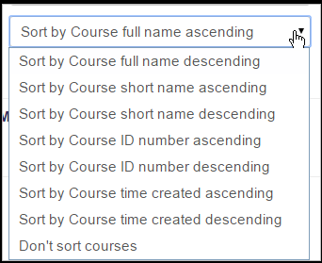
Sorting courses
Courses may be sorted by an admin or manager from Administration>Site administration>Courses>Manage courses and categories.
Courses may be sorted by ascending/descending and by time created.

Slide 43
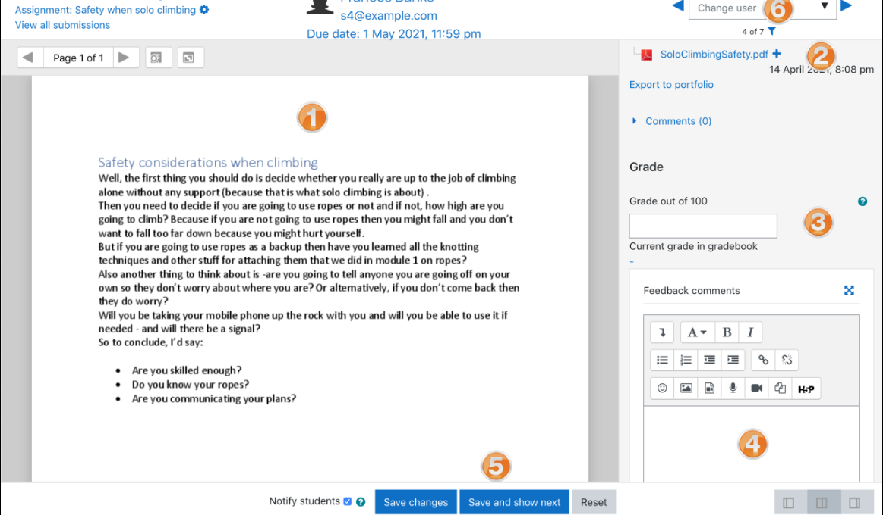
Teacher view:
Once students have submitted work, click on the assignment and click “Grades”
Here, the submission may be annotated (1) and/or downloaded (2); a grade entered (3) and individual feedback given (4). The teacher saves the changes (5) and moves to the next student (6)

Slide 44
What is the Forum activity?
The Forum activity allows students and teachers to exchange ideas by posting comments as part of a 'thread'. Files such as images and media maybe included in forum posts. The teacher can choose to grade and/or rate forum posts and it is also possible to give students permission to rate each other's posts.

Slide 45
How is it set up?
In a course, with the editing turned on, choose 'Forum' from the activity chooser.
Give it a name and, if needed, a description.
Choose your Forum type, clicking the question mark (?) icon for descriptions of each type. If you're unsure, use the default Standard forum for general use.
Expand the other sections to define the settings you want. For more help, see Forum settings.
Click Save and display and, optionally, add a post to get started.

Slide 46
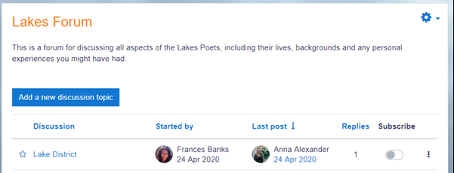
How does it work?
Student view
Students access the forum by clicking the icon on the course page and depending on the forum type selecting, will typically be see a button to start a new discussion topic. They can sort discussions, subscribe to discussions from the toggle button, and favorite/bookmark discussions from the star icon on the left. This moves the discussion to the top of the list, under any discussions pinned by the teacher.

Slide 47
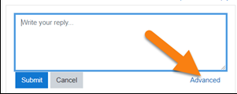
cont….
When starting a new discussion or replying If they click into a discussion, they have a link to reply and a 'Permalink'.
When replying, a basic text editor is available. Clicking the link Advanced displays the full editor and options such as uploading attachments.
Posts can be edited for a limited time,usually 30 minutes, dependent on the administrator's settings.

Slide 48
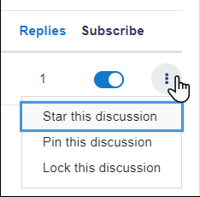
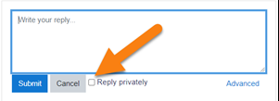
Teacher view
Teachers additionally have three dots to the right of the Subscribe option, allowing them to pin, star or lock discussions.
When replying to a forum post, teachers also optionally can send a Private reply which is only seen by that particular student. Students cannot reply to this private reply.

Slide 49
What is the Quiz activity?
The Quiz is a very powerful activity that can meet many teaching needs, from simple, multiple-choice knowledge tests to complex, self-assessment tasks with detailed feedback.
Questions are created and stored separately in a Question bank and can be reused in different quizzes.
When creating a Quiz you can either make the questions first and add them to the Quiz, or add a Quiz activity (as below) and create the questions as you go along.

Slide 50
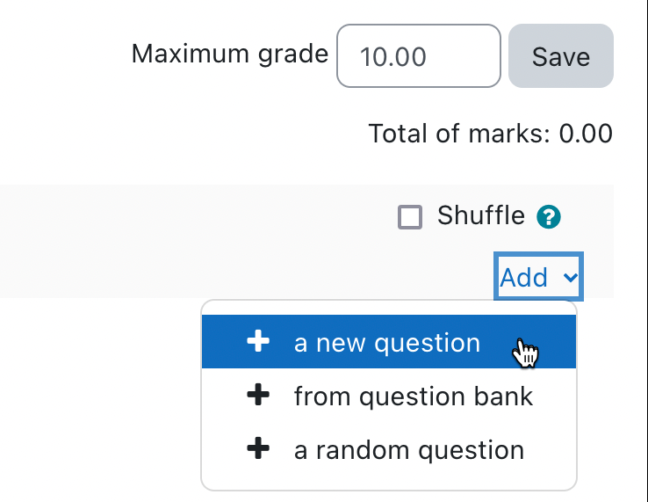
How is it set up?
In a course, with the editing turned on, choose Quiz from the activity chooser.
Give it a name and, if required, a description.
Expand the other sections to select the settings you want. With the default settings, students can repeat the quiz, moving freely between questions, each on a different page. There is no time limit and scores and feedback display once they have completed the quiz.
To change any of these defaults, and for more information on configuring your quiz, see Quiz settings.
Click Save and display.
Click Edit quiz
Click Add and then click '+ a new question' (If you already made questions in the question bank, then click '+ from question bank' or if you wish to add a question randomly picked from a category of questions, click '+ a random question'.)

Slide 51
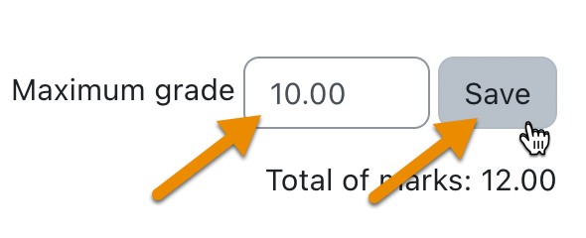
cont..
Choose the type of question you want to add and then click 'Add' at the bottom:
Add your question. For help, see the documentation Question types.
Click Save changes and repeat the steps for as many questions as you need.
Click 'Save changes' when you have made your question.
If you want, change the maximum grade for your quiz to reflect the number of questions.

Slide 52
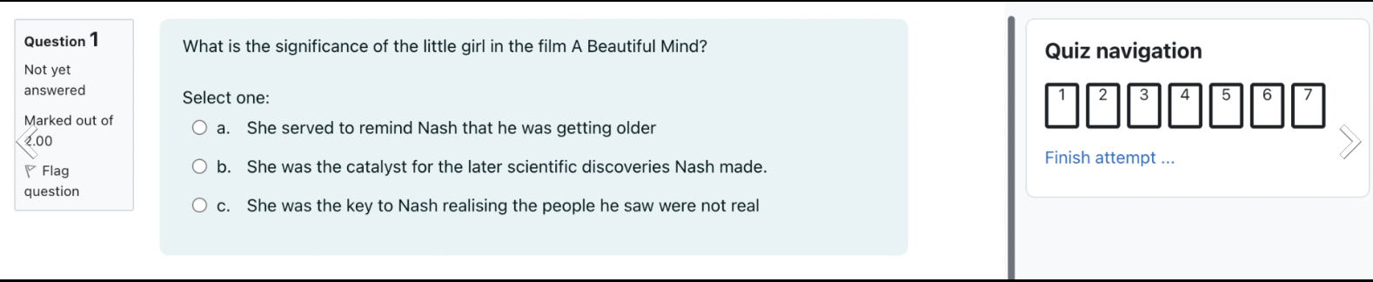
How does it work?
Student view
Quizzes are visible on the page once you add them so if you don't want them to see it as you are creating questions, hide it until you are ready.
Depending on the settings, students may see questions all on one page or on separate pages. There will be a block linking to each question.

Slide 53
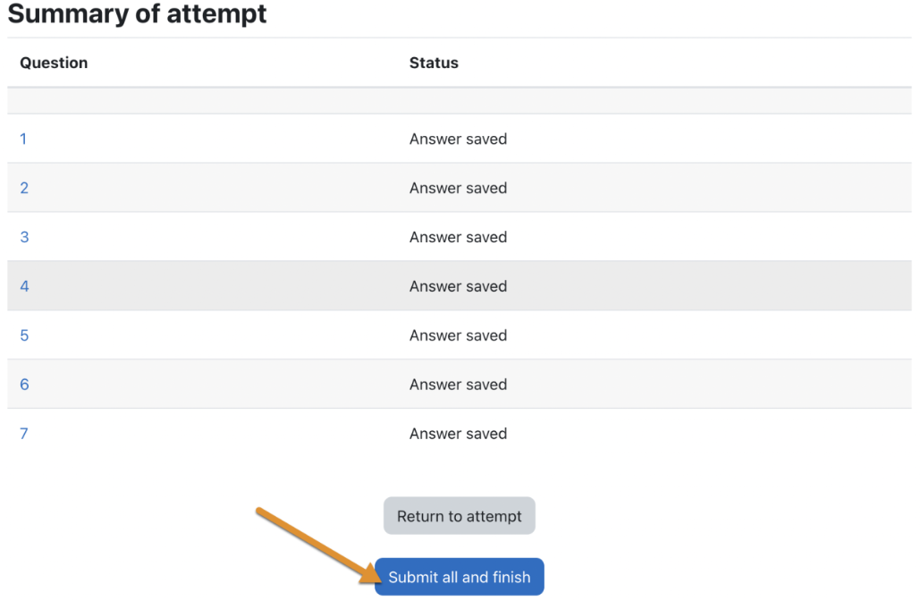
cont…
Students can flag questions to alert the teacher to possible queries.
In order to finish the quiz and potentially see their scores (depending on the settings) students must click 'Submit all and finish' when they reach the Summary of attempt page:

Slide 54
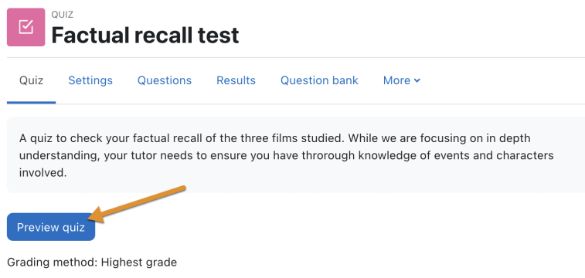
Teacher view
Teachers should preview the quiz to ensure it displays as desired for students:
Grades can be viewed either by clicking the quiz and the link 'Attempts' when students have attempted the quiz, or from the Actions menu top right > Results (as in the above screenshot).

Slide 55
Questions?
1) What is moodle ?
2) What do you want from an online learning system?
3) How to add new course using moodle ?
4) What are the different course management features ?
5) How to add quiz for students ?
6) What are different learner management features ?
7) Explain various features of homepage ?
8) Explain how to Add, Delete, Modify courses ?
9)What is a Forum Activity ?
10) What are the activities of managers site ?

Slide 56
THANK YOU

